Slide 1
Math. for CS
Chapter 1- What is a Proof?
Prof. Shunxiang Zhang
Anhui University of Science & Technology
Computer Science and Engineering
Mobile Phone：189-6377-7827
Email：sxzh666@gmail.com;sxzhang@aust.edu.cn

Slide 2
Suggestion for postgraduate study
P1：Is postgraduate study easy？
脚踏实地做好自己，提高动手能力
P2 ：If you know nothing about the research direction, how can you understand the professional research direction？
逐步了解本专业的主要研究方向
P3：If you are not major in computer science during the getting Bachelor degree, you should required course knowledge？
补五大核心课程及软件工程

Slide 3
Suggestion for postgraduate study
P4 ： What is your Possible job direction after graduation？
参考国内主要学校的研究方向，逐步深入了解
软件工程师、软件开发工程师、高级软件工程师、java软件工程师、软件测试工程师、嵌入式软件工程师、.net软件工程师、java开发工程师、android开发工程师、java高级软件工程师、网络维护工程师、系统安全工程师、UI界面设计。高校、科研院所、银行。

Slide 4
Suggestion for postgraduate study
P5：What is the main aspect of postgraduate training？
严谨的治学态度与自学能力
更加严谨的逻辑思维训练
有效的表达能力
P6：How to follow the frontiers of the discipline?
CSDN看看国内大牛们在讨论什么科学前
小木虫
问题7：Where to retrieve reference from journals and conferences？
CNKI （翟天临事件） ACM/IEEE/Springer
Elsevier/Wiley/Inderscience/IGI
Science/Nature

Slide 5
Suggestion for postgraduate study
P8：Do you want to read all references belongs to a research direction？
相关期刊查阅DBLP
http://www.letpub.com.cn/index.php?page=journalapp
谷歌学术（Google Scholar）在2012年推出了一个杂志评价系统，即谷歌学术计量（Google Scholar Metrics）
课程学习：如Coursera
问题9：How to improve their writing ability, and even form their own unique writing style？
多看多模仿
学习无捷径，态度是根本

Slide 6
5+1 main courses in Computer Science
Data structure
Principles of Computer Organization
Database
Computer Network
Operating System
Principles of Compiler

Slide 7
4 Learning Resources
Bibliographic Database
ACM/IEEE/Springer/Elsevier/Wiley/Inderscience/IGI
CNKI
Baidu Scholar/Google Scholar
Dblp: computer science bibliography
http://dblp.org/
en.wikipedia.org https://en.wikipedia.org/wiki/Main_Page

Slide 8
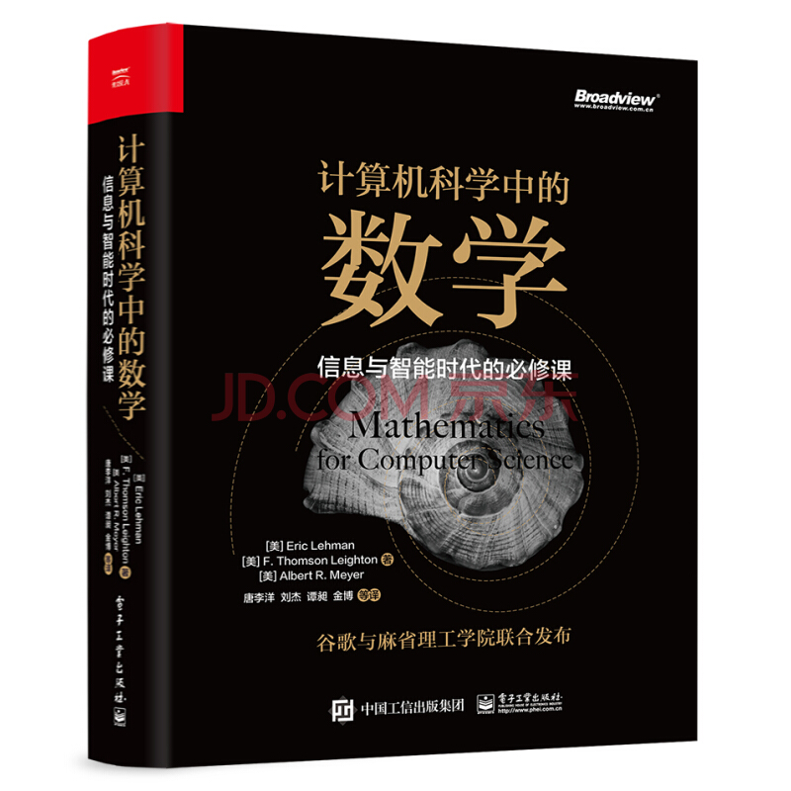
Score proportion of this course
Oral presentation and Performance in Class(50%)
Using Slides/ppt
Homework(20%)
Exam(30%)

Slide 9
Topics covered/Contents
1.1 Propositions
1.2 Predicates
1.3 The Axiomatic Method
1.4 Our Axioms
1.5 Proving an Implication
1.6 Proving an “If and Only If”
1.7 Proof by Cases
1.8 Proof by Contradiction
1.9 Good Proofs in Practice

Slide 10
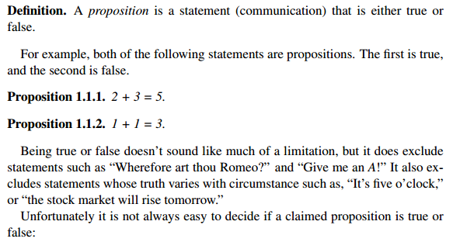
1.1 Propositions

Slide 11
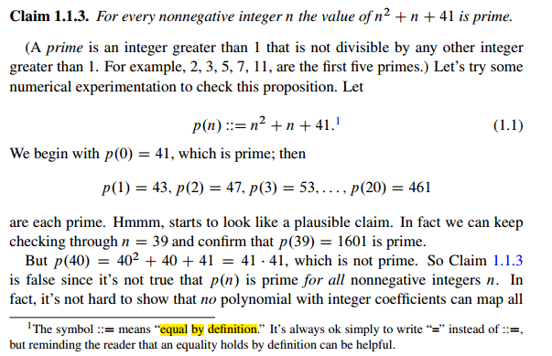
1.1 Propositions

Slide 12
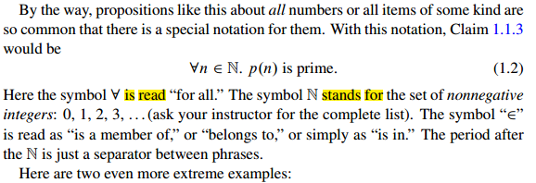
1.1 Propositions

Slide 13
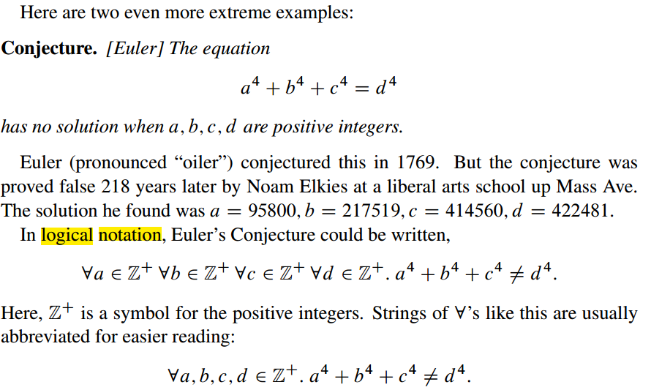
1.1 Propositions

Slide 14
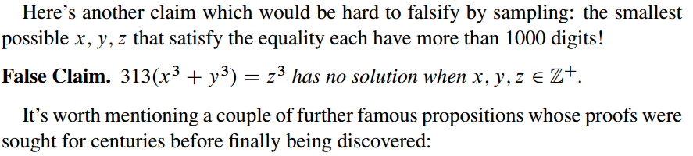
1.1 Propositions

Slide 15
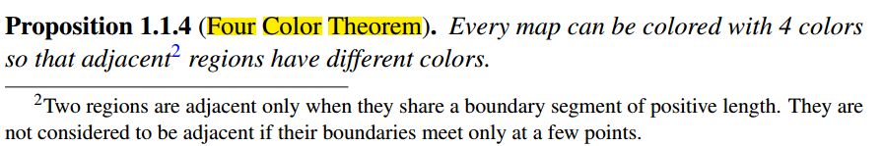
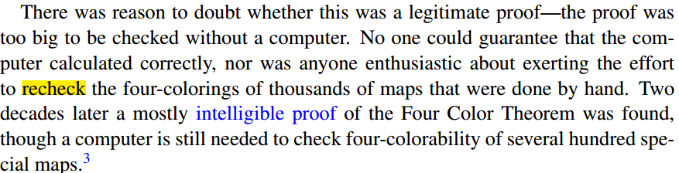
1.1 Propositions

Slide 16
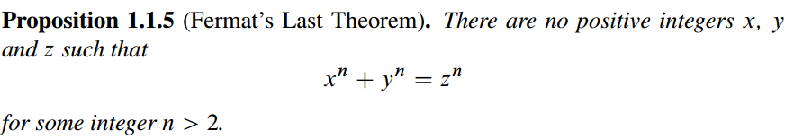
1.1 Propositions

Slide 17
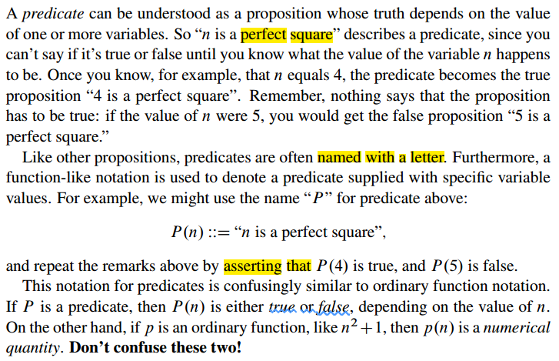
1.2 Predicates

Slide 18
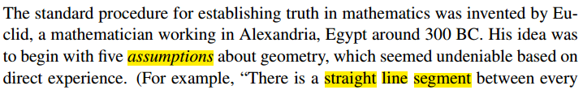
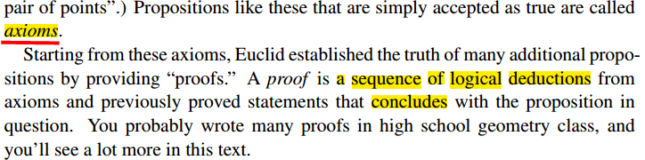
1.3 The Axiomatic Method

Slide 19
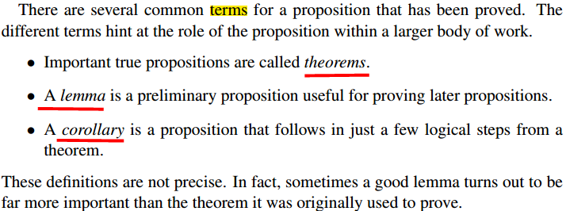
1.3 The Axiomatic Method

Slide 20
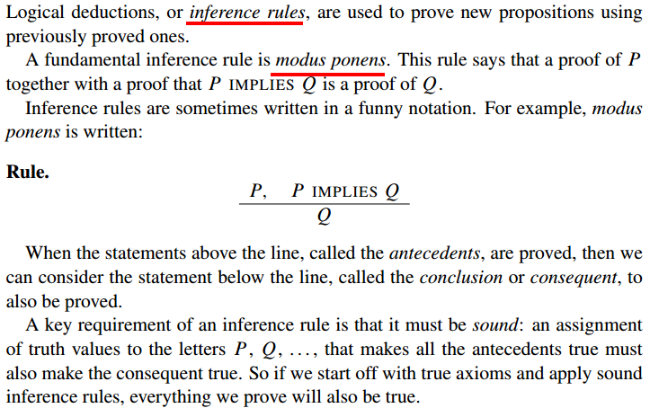
1.4 Our Axioms

Slide 21
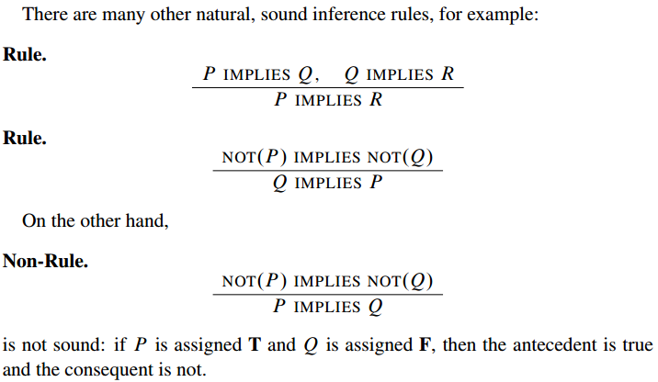
1.4 Our Axioms

Slide 22
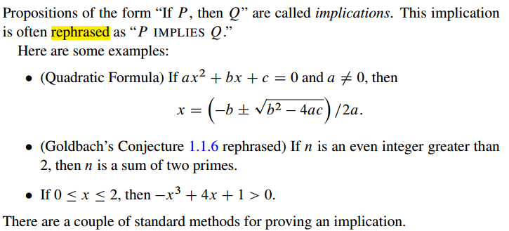
1.5 Proving an Implication

Slide 23
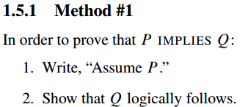
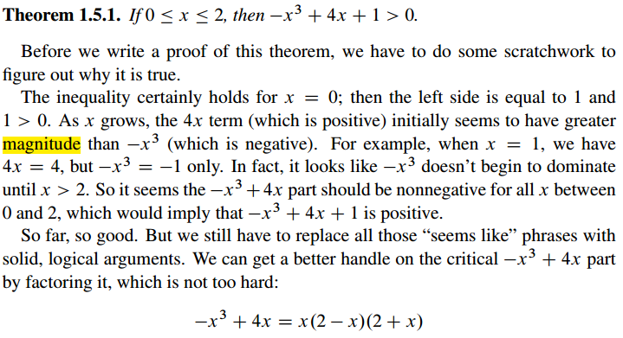
1.5 Proving an Implication

Slide 24
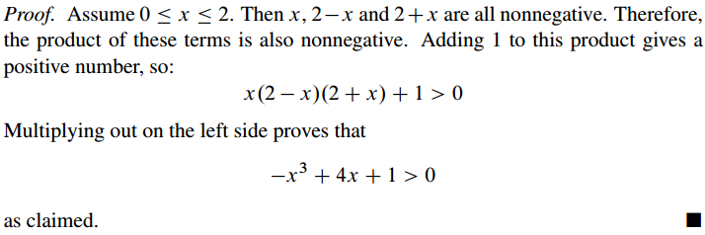
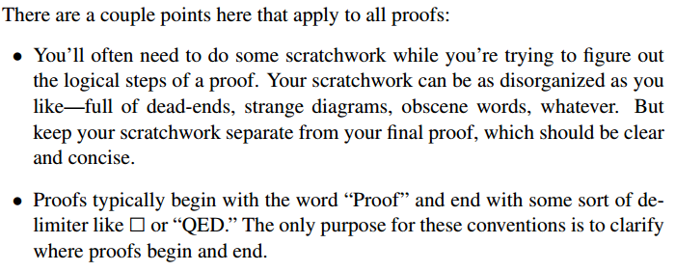
1.5 Proving an Implication

Slide 25
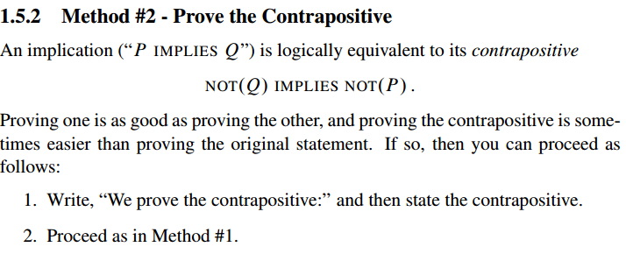
1.5 Proving an Implication

Slide 26
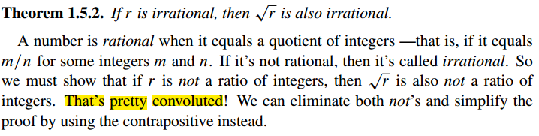
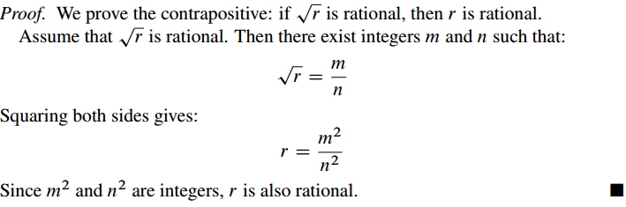
1.5 Proving an Implication

Slide 27
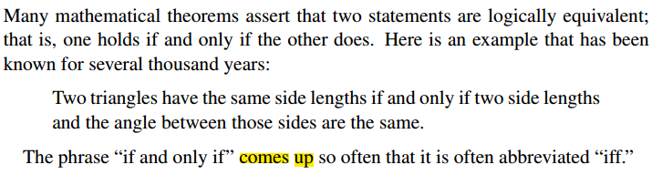
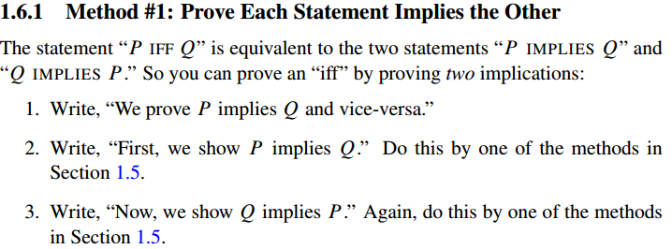
1.6 Proving an “If and Only If”
Notes:
Holds, satisfy
Comes up, appear, arise

Slide 28
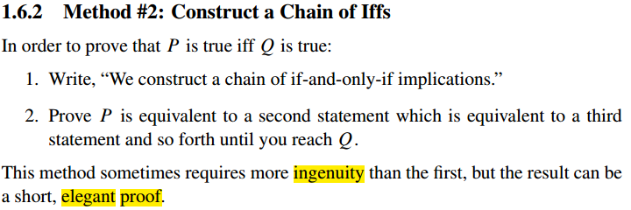
1.6 Proving an “If and Only If”

Slide 29
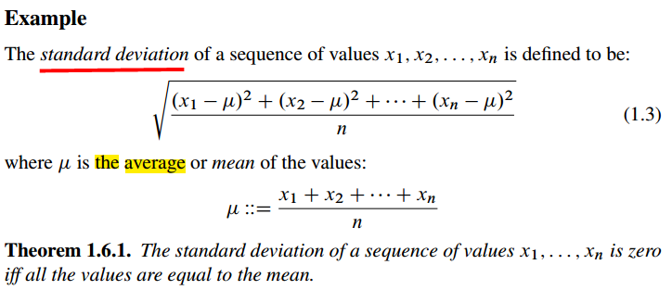
1.6 Proving an “If and Only If”

Slide 30
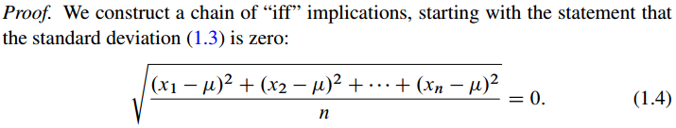
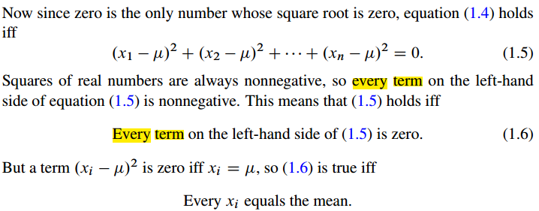
1.6 Proving an “If and Only If”

Slide 31
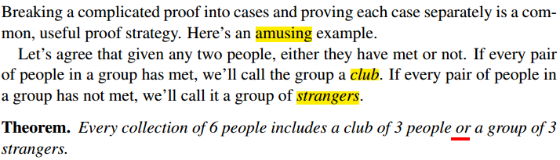
1.7 Proof by Cases

Slide 32
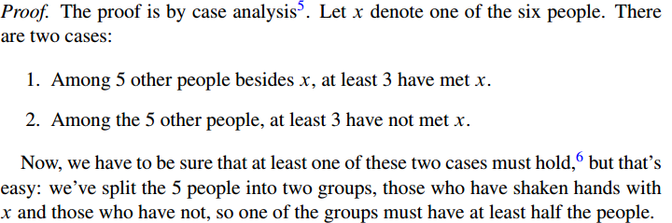
1.7 Proof by Cases

Slide 33

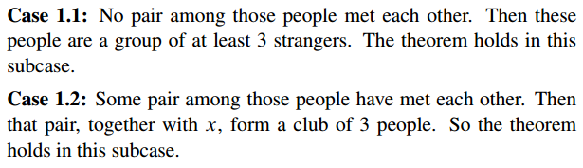
1.7 Proof by Cases

Slide 34
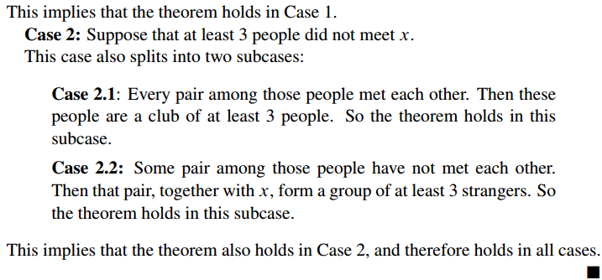
1.7 Proof by Cases

Slide 35
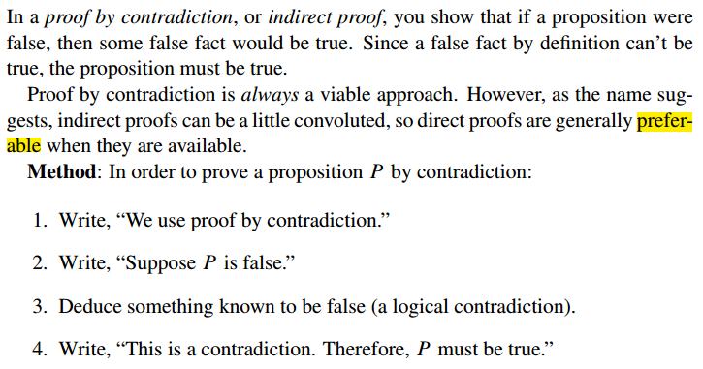
1.8 Proof by Contradiction

Slide 36
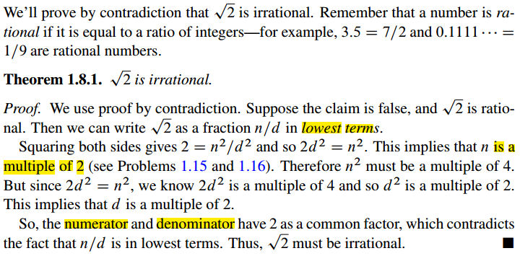
1.8 Proof by Contradiction

Slide 37
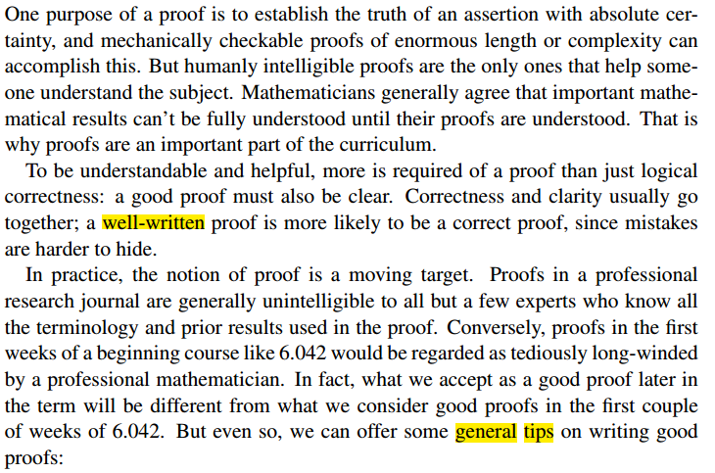
1.9 Good Proofs in Practice

Slide 38
1.9 Good Proofs in Practice

Slide 39
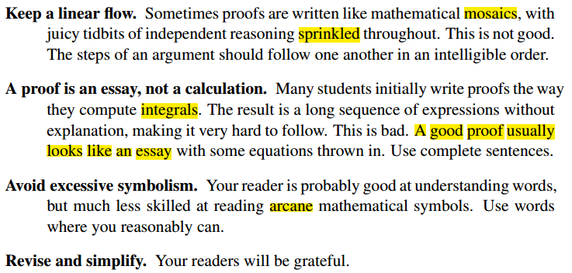
1.9 Good Proofs in Practice

Slide 40
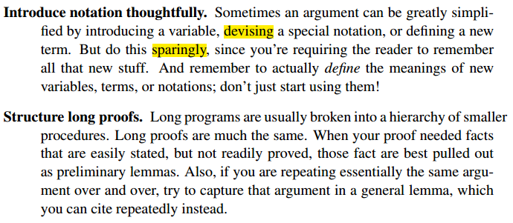
1.9 Good Proofs in Practice

Slide 41
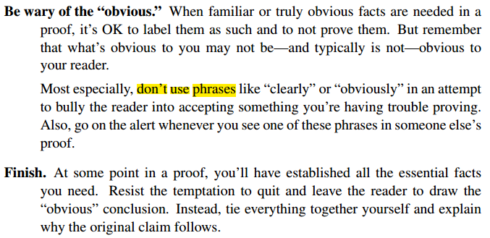
1.9 Good Proofs in Practice

Slide 42

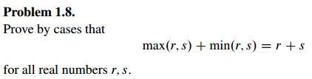

1.10 Group/Panel discussion
Group 1

Slide 43
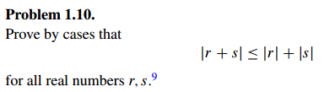
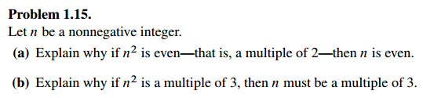
1.10 Group/Panel discussion
Group 2

